Slide 1

Office Rental Service
Capstone Project Defense
Supervisor: Mr. Nguyễn Trọng Tài
Members : Lê Xuân Tiến
Nguyễn Vũ Hoàng Quốc
Trương Tiến Thành
Trần Lê Tuấn

Slide 2
Contents
Current Situation
Solution
Business Model
Revenue Model
System Component
Project Features
Search Office - Request Appointment - Create Contract
Request Office
Request Rental/Repair
Extend and Return contract
Statistic and Management
Pros and Cons
Future Development
Notes:
Chia lại luồng search – appointment, accept – contract - extend contract, Repair request,

Slide 3
Current Situation

Slide 4
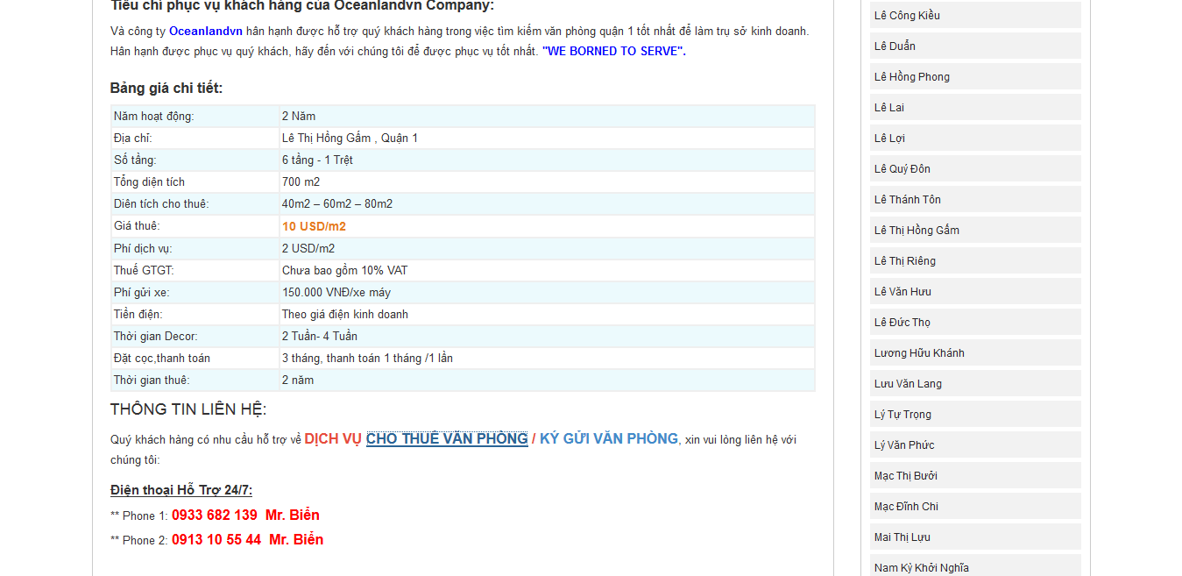
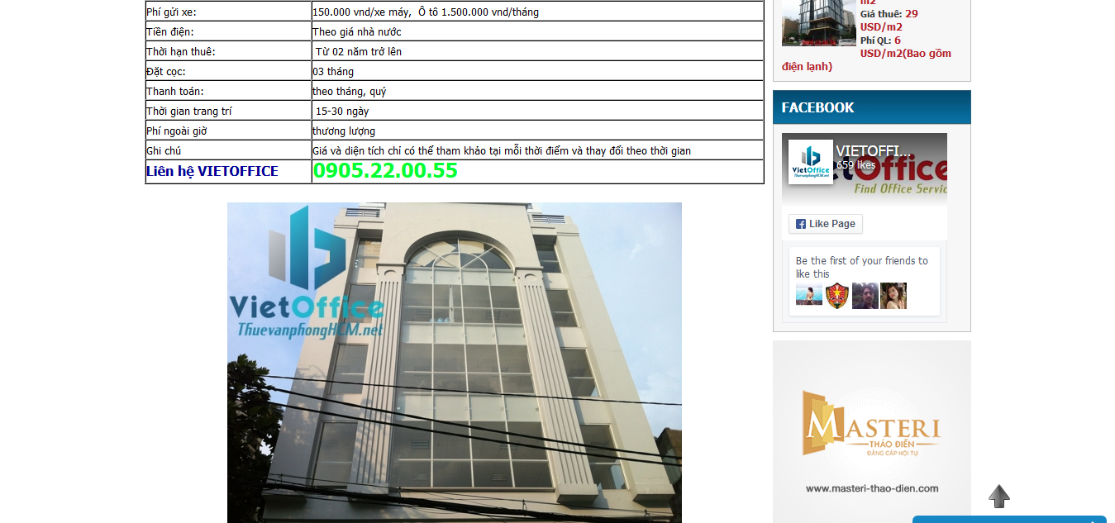
Current Situation
Only provide information of offices.
Customers contact with owners directly.
Owners hardly to sign the contract.
http://vanphonggiatotchothue.com
http://www.vanphongchothuequan1.com.vn
Notes:
customer service: appointment, rental and repair service

Slide 5
Solution

Slide 6







Business Model
Supplier
Office Rental Service System
Customer
Contact with
Manager
Staff
Owners
Manage
Belong to
Customer
System
Offices
Notes:
customer service: appointment, rental and repair service

Slide 7


Revenue Model Based on commission
Supplier
Office Rental Service System
Customer
Give
Rent
Owners
Price
Contract
Customer
Commission
Manager

Slide 8
Revenue Model Based on price difference
Supplier
Office Rental Service System
Customer
Give
Base price
Owners
Rent
Price
Contract
Customer
Give
Manager

Slide 9
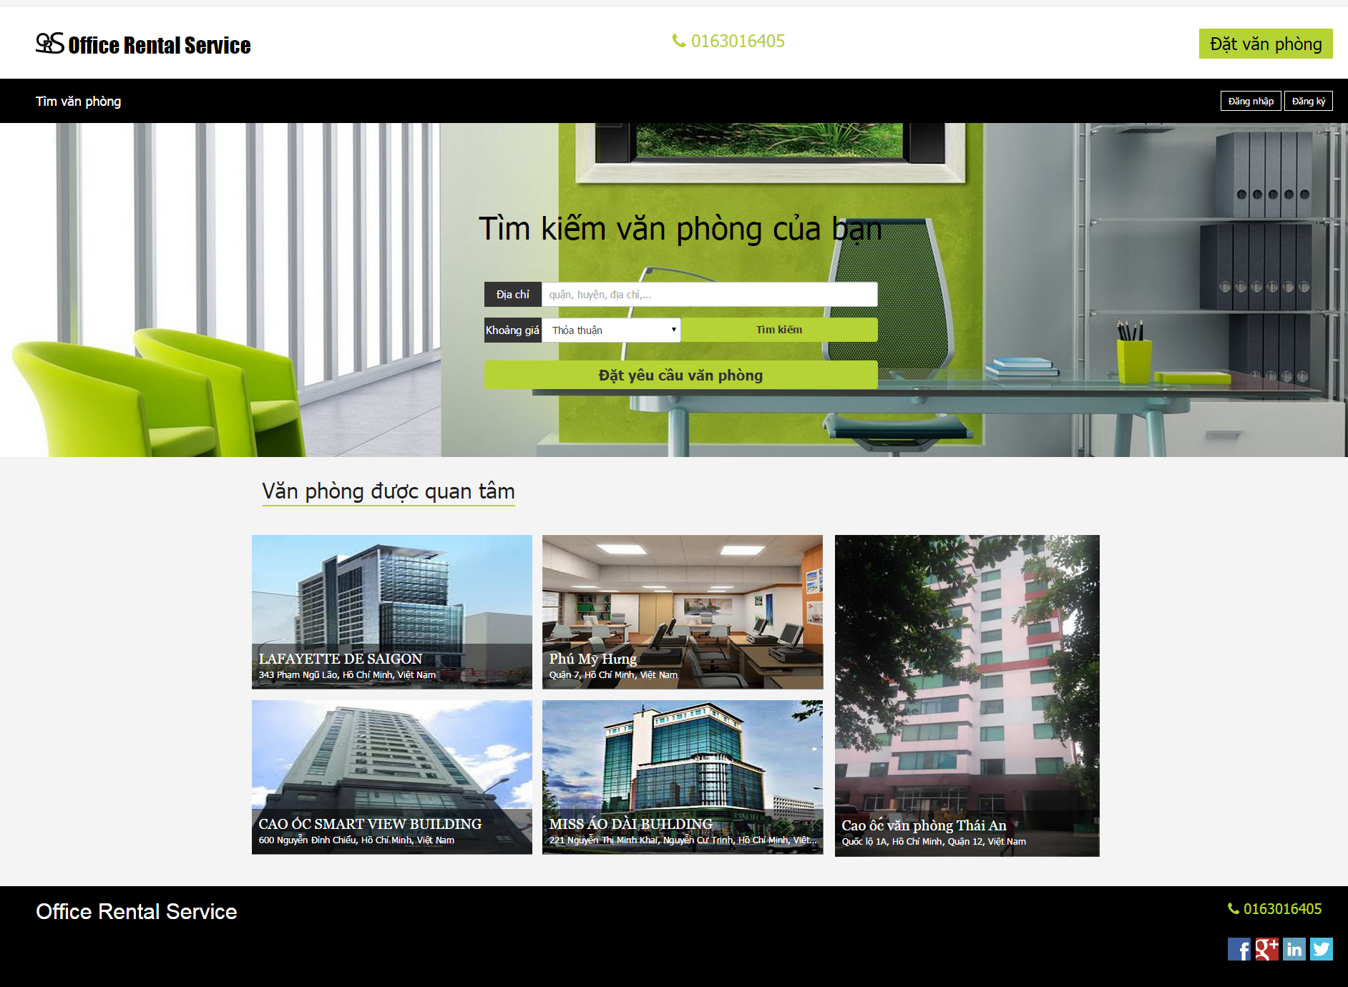
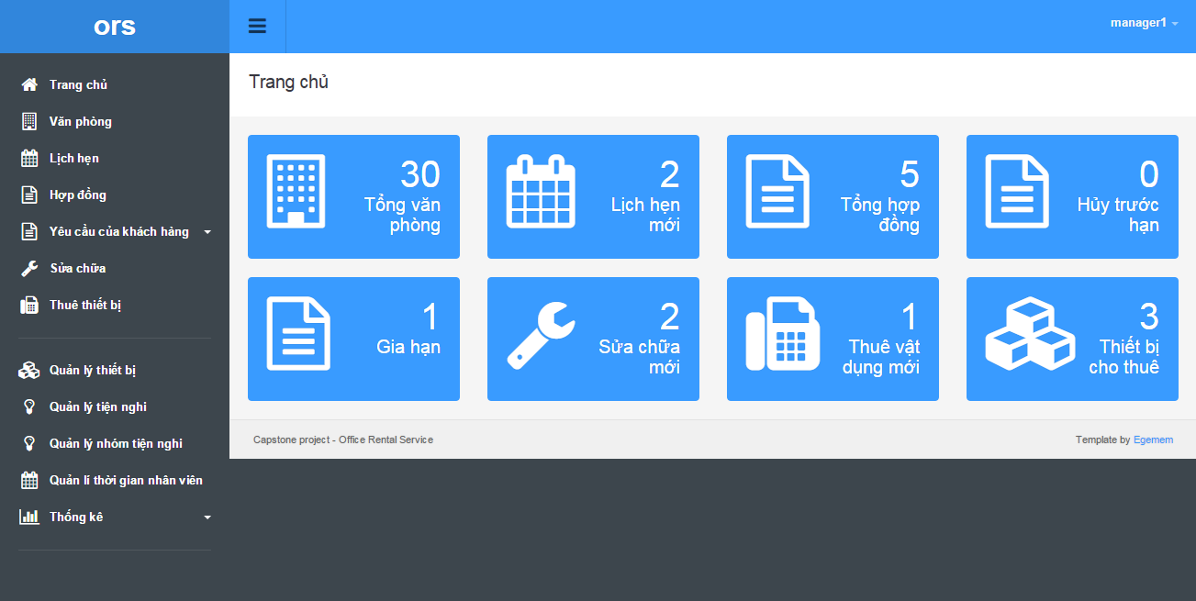

System component
Office Rental Service System
Search office
Request appointment
Manage office
Manager
Staff
Customer
Manage appointment
Request office
Create contract
Manage contract
Customer service
Back office service
Manage repair/ rental
Request repair/ rental
Staff
Mobile
Check assigned request
Check appointment

Slide 10
Project Features

Slide 11

Project Features Search Office - Request Appointment - Create Contract
Office Rental Service
1
Choose an
office
Create appointment
2
7
Manager
Customer
Check appointment
3
Decide create contract
6
System
Create Contract
Assign
to staff
8
4
Contract
Meet and check office
5
Staff

Slide 12


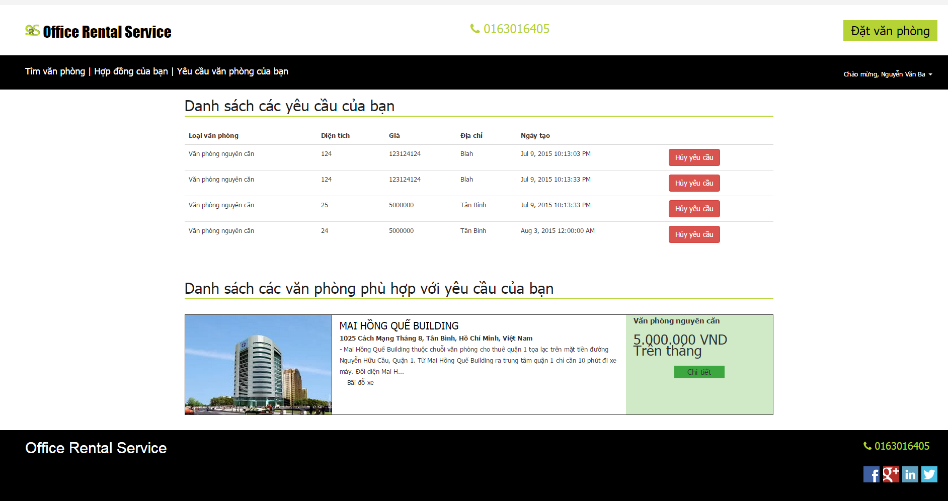
Project Features Request Office
Office Rental Service
Schedule check
2
Send email
4
Email
Belong to
Return data
System
3
Database
Create request
1
5
Check request
Customer
Result page

Slide 13
Project Features Request Rental/Repair
Office Rental Service
Send SMS
Check request
4
2
Send request
Manager
1
Customer
System
Assign
Accept/Reject
3
7
Accept/Reject
6
Meet customer
5
Staff
Notes:
Trong lúc kh sử dụng vp, kh có nhu cầu sửa chữa thiết bị hoặc khi kh muốn thuê thêm vật dụng thì họ có thể gửi yêu cầu lên hệ thống của chúng tôi. Sau khi kh gửi yêu cầu, người quản lý sẽ kiểm tra yêu cầu đó rồi giao việc cho nhân viên. Hệ thống sẽ tụ động gửi 1 tin nhắn báo cho khách hàng biết ngày nhân viên đến sửa chữa hoặc giao vật dụng. Nv sẽ đến kiểm tra xem yêu cầu đó có chính đáng ko. Nếu chính đáng thì nv sẽ chấp nhận, nếu yêu cầu đó phi lý thì nv sẽ từ chối. Sau khi thực hiện yêu cầu, kh sẽ xác nhận lại với nhân viên. Nếu kh ko hài lòng thì người quản lý sẽ giao cho nhân viên khác xử lý.

Slide 14
Project Features Extend/Return contract
Office Rental Service
Send request
1
Check, then
Accept or
cancel request
2
Customer
Manager
System

Slide 15




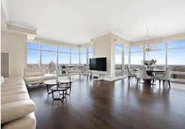

Project Features Management
Request
Appointment
Rental
Manager
Contract
Statistic
Rental item
Amenity

Slide 16
Pros and Cons

Slide 17
Pros and Cons
Pros:
Providing search engines criteria: price, location, amenities...
Making an appointment easily.
Manage contract easily.
The customer’s requests are automatically suggest by system.
Helping staff easily to manage and update their jobs by mobile application.

Slide 18
Pros and Cons
Cons:
Owner of the office must contact us to post their information.
The function of notification system is limited.
Only in Ho Chi Minh city.

Slide 19
Future Development

Slide 20
Future Development
Mobile application for customer.
Owner can create and manage their office.
Extend system for different locations.

Slide 21
Q&A

Slide 22
K-Means Algorithm

Slide 23
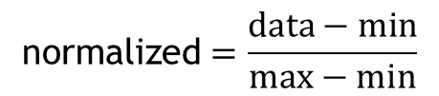
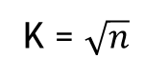
K-Means Algorithm
Start
K = $\sqrt{n}$
Calculate K
$$\text{normalized}=\frac{data−min}{max−min}$$
Normalize data
Group data in K groups

Slide 24
K-Means Algorithm
Start
Calculate K
Normalize data
Group data in K groups
Yes
Group changed?
Calculate the mean of each group
Group based on minimum distance to mean
No
End

Slide 25
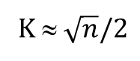
KNN Algorithm
Start
Calculate K
K ≈ $\sqrt{n}/2$
Normalize query point
Calculate min K distance from query point to sample points
More than 1 most frequency
Yes
Return min distance group
No
End

Slide 26
Suggest Schedule
Start
Init schedule
Unassigned job
Suggest assign day (?)
Available staff in assign day?
No
Yes
Suggest assign to staff which have least jobs
Yes
Still have unassigned job
Update schedule
No
End

Slide 27
Thanks for your listening

